Slide 1
﻿Deep learning based classification of focal liver lesions with contrast-enhanced ultrasound
Authors: ﻿Kaizhi Wu, Xi Che, Mingyue Ding
Published in 2014
Presented by Xiaopeng Jiang

Slide 2
Outline
The paper is about ﻿a diagnostic system of liver disease classification based on contrast enhanced ultrasound (CEUS) imaging.
The dynamic CEUS videos of hepatic perfusion are firstly retrieved.
﻿Secondly, time intensity curves (TICs) are extracted from the dynamic CEUS videos using sparse non-negative matrix factorizations.
﻿Finally, deep learning - Deep Belief Networks (DBNs) is employed to classify benign and malignant focal liver lesions based on these TICs.

Slide 3
Background
Primary liver cancer is the sixth most common cancer worldwide, and the third most common cause of death from cancer.
Biopsy is currently the golden standard for diagnosing cancer, but it is invasive, uncomfortable, and is not always a viable option depending on the location of the tumor.
Noninvasive diagnosis of focal liver lesions (FLLs) can be evaluated by using CEUS (contrast enhanced ultrasound) to determine the liver vascularization patterns in real-time, and thus, improve the diagnostic accuracy for the classification of FLLs

Slide 4
Background
Enhancement patterns of FLLs in the arterial and portal venous phases of CEUS can be used for characterizing FLLs
Time intensity curves (TICs) are a graphical illustrating representative contrast uptake kinetics represented in a CEUS investigation.
Based on the TICs of CEUS, diagnostic systems had been developed to assist ultrasonographist in liver cancer processing to further improve the diagnostic accuracy.

Slide 5
Limitations of TICs
Extraction of TICs is susceptible to noise
TICs obtained from region of interest (ROI) measurements may be composites of activities from different overlapping components in the selected ROI.
Feature selection was determined empirically and always operator-dependent.
The parameters setting are based on the experimental knowledge

Slide 6
Proposed Study
Deep learning combines the feature extraction and recognition together perfectly.
The feature extraction is implemented from low level to high level through unsupervised feature learning instead of being hand-designed.
To overcome the subjectivity of TICs extracted with manual ROI selection and the impact of speckle noise, an automatical TICs extraction method is used - Factor Analysis of Dynamic Structures(FADS) techniques.

Slide 7
Data acquisition
Real-time side by side contrast-enhanced mode continuous video clip with a mechanical index of less than 0.20 were acquired at a frame rate of 8-15 fps
The study population comprised 22 patients with 26 lesions
Positive diagnosis was reached through a combination of other imagistic methods (CT and CE-MRI), liver biopsy in uncertain cases or followup for a minimum period of sixth months
To minimize the impact of breathing motion on TICs extraction, combining of template matching and frame selection was applied to compensate respiratory motion throughout each CEUS video

Slide 8
Sparse non-negative matrix factorizations
A sparse non-negative matrix factorizations was introduced to extract the TICs from the dynamic CEUS image sequences.
Objective function
Input A: dynamic CEUS image sequence
Output Matrix C and matrix F are the coefficients image and the TICs which defined in FADS model

Slide 9
TICs extraction using SNMF
The objective function is solved by the alternating non-negativity-constrained least squares (ANLS) algorithm. The sparse NMF (SNMF) algorithm begins with the initialization of F with non-negative values.
Then, it iterates ANLS until it is convergence.

Slide 10
Deep learning
Deep probabilistic generative models - Deep Belief Networks (DBNs)
Generative models provide a joint probability distribution over observable data and labels
DBNs are composed of several layers of restricted Boltzmann machines (RBM)
The DBN can be trained in a purely unsupervised way, with the greedy layer-wise procedure in which each added layer is trained as an RBM by contrastive divergence.

Slide 11
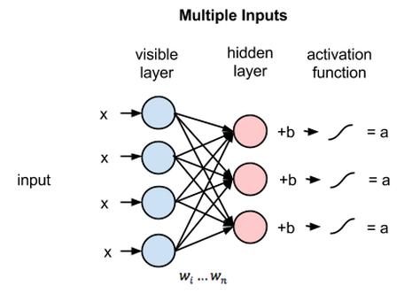
RBM Overview - Forward Pass
Each hidden node receives the four inputs multiplied by their respective weights. The sum of those products is again added to a bias (which forces at least some activations to happen), and the result is passed through the activation algorithm producing one output for each hidden node.
Credit: https://skymind.ai/wiki/restricted-boltzmann-machine

Slide 12
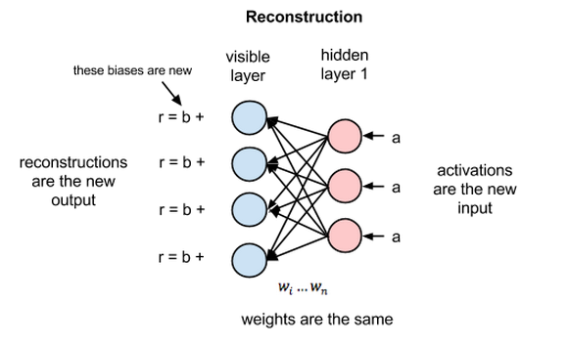
Reconstructions - Backward Pass
In the reconstruction phase, the activations of hidden layer no. 1 become the input in a backward pass. They are multiplied by the same weights, one per internode edge, just as x was weight-adjusted on the forward pass. The sum of those products is added to a visible-layer bias at each visible node, and the output of those operations is a reconstruction; i.e. an approximation of the original input.
The reconstruction doesn’t require the label of the data, so RBM can be used as unsupervised learning.
Credit: https://skymind.ai/wiki/restricted-boltzmann-machine

Slide 13
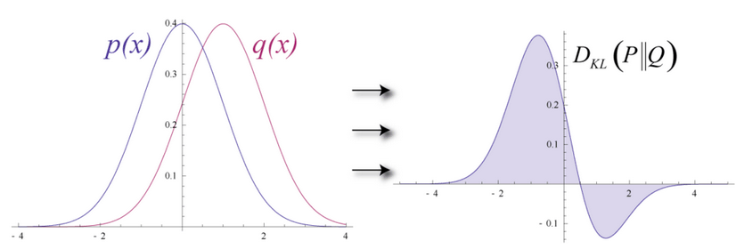
Error Term
Together, those two estimates will lead you to the joint probability distribution of inputs x and activations a, or p(x, a).
Imagine that both the input data and the reconstructions are normal curves of different shapes, which only partially overlap.
Credit: https://skymind.ai/wiki/restricted-boltzmann-machine

Slide 14
Framework of the classification system

Slide 15
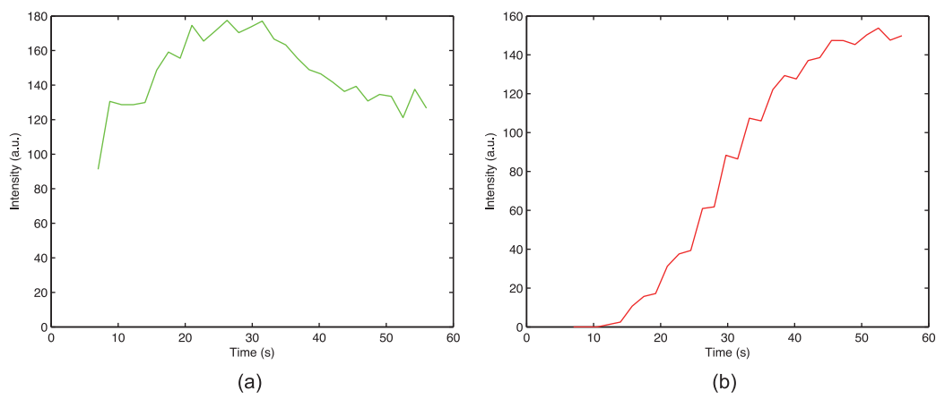
Results - TICs
﻿malignant lesions
﻿benign lesions

Slide 16
﻿Classification Results
Tenfold cross-validation
DBN: learning rate: 0.1, the max epoch: 100, the momentum for smoothness: 0.5, and the weight decay factor: 2e−4
SVM: linear Kernel function
KNN: number of neighbors:10, Euclidean distance
BPN: Feed-Forward network, learning rate: 0.01, max epoch: 500, and training target error: 0.01.

Slide 17
DBN
one hidden layer
two hidden layer
three hidden layer
Units | Accuracy | Sensitivity | Specificity
5 | 87.95 ± 4.02 | 89.16 ± 7.85 | 87.74 ± 5.09
10 | 87.95 ± 3.56 | 89.59 ± 7.16 | 87.75 ± 4.87
20 | 87.95 ± 4.42 | 88.70 ± 7.79 | 87.58 ± 5.09
30 | 87.95 ± 4.29 | 88.56 ± 7.20 | 87.27 ± 4.75
40 | 87.95 ± 6.07 | 89.79 ± 13.19 | 87.51 ± 6.74
50 | 87.95 ± 4.02 | 89.56 ± 5.25 | 87.41 ± 5.90
60 | 87.95 ± 5.36 | 89.20 ± 13.10 | 87.51 ± 5.10
70 | 87.95 ± 4.55 | 90.44 ± 9.30 | 87.55 ± 4.92
80 | 87.95 ± 4.68 | 89.82 ± 6.51 | 87.36 ± 6.15
90 | 87.95 ± 5.67 | 89.48 ± 10.18 | 87.76 ± 7.31
100 | 87.95 ± 4.02 | 89.00 ± 8.47 | 87.43 ± 4.07
200 | 87.95 ± 6.59 | 89.33 ± 7.19 | 87.81 ± 7.54
Units | Accuracy | Sensitivity | Specificity
5 | 87.95 ± 4.16 | 89.39 ± 16.07 | 87.44 ± 5.45
10 | 87.95 ± 3.56 | 89.90 ± 8.06 | 87.56 ± 4.08
20 | 87.95 ± 6.86 | 89.07 ± 8.35 | 87.30 ± 8.71
30 | 87.95 ± 5.47 | 88.30 ± 14.78 | 87.41 ± 5.05
40 | 87.95 ± 4.68 | 89.93 ± 9.53 | 87.37 ± 5.08
50 | 87.95 ± 4.92 | 88.58 ± 9.90 | 87.70 ± 5.40
60 | 87.95 ± 4.92 | 88.37 ± 12.24 | 87.36 ± 6.87
70 | 87.95 ± 5.77 | 89.41 ± 9.34 | 87.37 ± 7.13
80 | 87.95 ± 3.87 | 88.53 ± 6.24 | 87.69 ± 4.02
90 | 87.95 ± 3.40 | 89.23 ± 8.98 | 87.53 ± 3.11
100 | 87.95 ± 3.72 | 89.60 ± 6.19 | 87.64 ± 4.03
200 | 87.95 ± 3.40 | 89.29 ± 9.16 | 87.50 ± 3.72
Units | Accuracy | Sensitivity | Specificity
5 | 87.95 ± 4.29 | 88.96 ± 7.32 | 87.59 ± 5.28
10 | 87.95 ± 5.25 | 88.64 ± 10.39 | 87.46 ± 4.23
20 | 87.95 ± 5.47 | 88.47 ± 7.94 | 87.30 ± 8.71
30 | 87.95 ± 5.67 | 88.87 ± 11.43 | 87.42 ± 6.33
40 | 87.95 ± 6.34 | 89.59 ± 7.68 | 87.43 ± 6.50
50 | 87.95 ± 3.56 | 89.28 ± 6.65 | 87.86 ± 8.91
60 | 87.95 ± 6.07 | 89.29 ± 9.49 | 87.26 ± 4.33
70 | 87.95 ± 5.67 | 89.65 ± 6.50 | 87.66 ± 6.35
80 | 87.95 ± 4.55 | 89.49 ± 6.84 | 87.79 ± 6.75
90 | 87.95 ± 3.56 | 88.15 ± 8.50 | 87.48 ± 5.36
100 | 87.95 ± 4.92 | 89.43 ± 7.51 | 87.74 ± 6.99
200 | 87.95 ± 3.22 | 89.64 ± 9.25 | 87.42 ± 4.50

Slide 18
Compare Results
Algorithm | Accuracy | Sensitivity | Specificity
LDA | 81.82 | 66.67 | 81.25
KNN | 83.33 | 80.00 | 82.45
SVM | 77.27 | 66.67 | 81.25
BPN | 82.58 | 81.86 | 86.61
Proposed | 86.36 | 83.33 | 87.50

Slide 19
Conclusion
The proposed method trains the classification model through deep learning based on the TICs extracted from CEUS videos.
Deep learning allows unsupervised pre-training to achieve good generalization performance in practice.
The accuracy, sensitivity and specificity values are higher than other compared methods.

Slide 20
Thank you.

